Slide 1
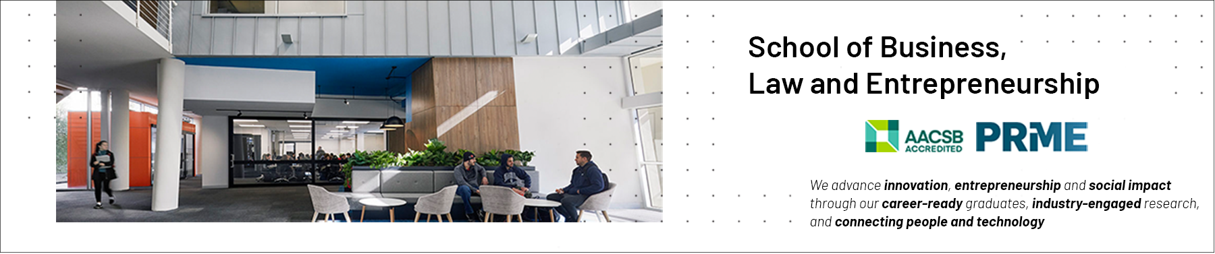

Communities of Practice (CoPs): Presentation 2
Professional Capabilities for a Digital World

Slide 2

This session’s roadmap & ULOs
What we will be covering.
Communities of Practice (CoPs)
Evolution from Information Systems settings
Relationship between CoPs and you as an ICT Professional
Unit Learning Objectives (ULOs).
Review the roles and responsibilities of ICT professionals in organisations and society from a range of perspectives such as work-life balance, mentoring and life-long learning.
What you need to do with this recorded presentation.
Watch, reflect and take your own notes in prep for the investigative case study.
Jot down any queries you may have on the concepts ready for the weekly LIVE catchup classes.
How long will this task take.
This task will take approx. 15 minutes to complete.

Slide 3
THIS SESSION’S OBJECTIVES
Define & characterise Communities of Practice (CoPs)
Explore the evolution of CoPs
Explore the core components of CoPs such as shared repertoires, joint enterprise and mutual engagement
Identify CoPs in industry & project teams
Explore how CoPs will feature in your roles as ICT Professionals
Be more knowledgeable leaving than arriving
Notes:
3

Slide 4
COMMUNITIES OF PRACTICE (CoPs)
Communities of Practice, often simply referred to as CoPs, are groups of people who share a concern or a passion for something they do and learn how to do it better as they interact regularly” (Wenger, 2008, p. 1).
Have you been in a group with these characteristics?
Domain
Practice
Community
Notes:
4

Slide 5
COMMUNITIES OF PRACTICE (CoPs) /2
A group of people who have a shared past, hope to have a shared future, have some form of acquiring new members, and have some means of recognizing and maintaining differences between themselves and other communities (Traweek 1988).
Self-reproducing, emergent and evolving entities that frequently extend beyond formal organisational structures (Schlager and Fusco 2003).
CoPs should be designed for evolution “because communities are built on existing networks and evolve beyond any particular design, the purpose of a design is not to impose a structure but to help the community develop” (Wenger, McDermott, & Snyder, 2002, p. 53).
Communities may emerge naturally or may be created deliberately according to Fontaine (2001).
Notes:
5

Slide 6
LEGITIMATE PERIPHERAL PARTICIPATION
CoPs have their origin in the theory of Legitimate Peripheral Participation.
LPP is a process “by which newcomers and old-timers become a part of a community of practice” (Lave & Wenger, 1991, p. 29).
An assumption underlying CoP theory is that learning occurs not only as a cognitive change in the learner but also as a social trajectory within a group.
The social identities of learners change as the learners become recognized as experts within a social group that shares a set of practices (Job-Sluder & Barab, 2004, p. 377).
Notes:
6

Slide 7
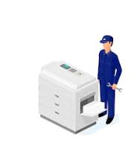
EVOLUTION OF CoP CONCEPT
Insurance claims processors and Xerox photocopy machine repair technicians.
Through networking and sharing their experiences the claims processors and repair technicians improved their efficiency, effectiveness, created positive customer satisfaction and increased business value for their organisation.
Notes:
7

Slide 8
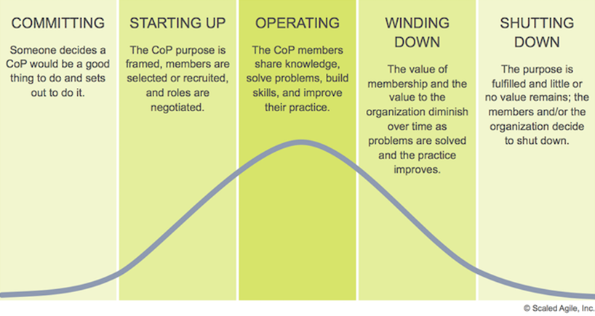
CoP STAGES OF DEVELOPMENT
Notes:
8

Slide 9
INDICATORS OF CoPs / SIGNS TO LOOK FOR…
There are a range of indicators of a CoP.
Members having a strong sense of identity tied to the community.
The practice of the community being not fully captured in formal procedures.
A continuing mutual relationships (which may be harmonious or conflicting) for members of the community.
A rapid flow of information between and among members which Nickols (2000) calls a really effective ‘grapevine’.
Behaviour patterns which indicate members of the community such as gestures, postures and even seating patterns in meetings.
Notes:
9

Slide 10
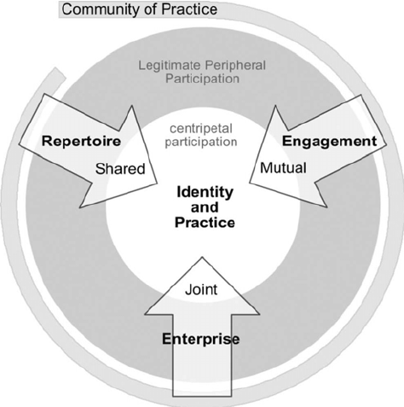
CORE ELEMENTS OF CoPs
Three key elements of a CoP: joint enterprise, mutual engagement and shared repertoires.
Members of a CoP are bound together by their collectively developed understanding of what their community is about and how they hold each other accountable to this sense of joint enterprise.
Members of a CoP interact with each other establishing norms and relationships as mutual engagement and make use of communal resources (shared repertoires) such as language, routines, sensibilities, artifacts, tools, stories and styles.
Notes:
10

Slide 11
THE VALUE OF COMMUNITY IN CoPs /
Value of a community is rarely evident when it is formed.
Value often changes over the life of the community.
CoPs as alternative learning models of performance training in corporations found the degree of trust within a CoP to be one of the most important factors for sharing tacit knowledge.
Achievement of tacit knowledge but also implicit knowledge which is passed by practice at a group level rather than a personal level.
A deep “sense of the value of participation to the community” through the member “becoming part of the community” (Lave & Wenger, 1991, p. 111).
Notes:
11

Slide 12
YOUR TOUCHPOINTS WITH CoPs AS AN ICT PROFESSIONAL
Internal Project Teams
External Project Teams
Conversation Circles
Pro Bono, Volunteer, Passion Projects
R&D Community
Associations, Societies, Special Interest Groups (SIGs)
IIBA Meetups, Walk & Talks
Notes:
12

Slide 13
HAVE WE MET OUR OBJECTIVES.
Defined & characterised Communities of Practice (CoPs)
Explored the evolution of CoPs
Explored the core components of CoPs such as shared repertoires.
Identified CoPs in industry & project teams
Explored how CoPs will feature in your roles as ICT Professionals
Wrapped up the topic with a useful overview video
Become more knowledgeable leaving than we were arriving
Notes:
13

Slide 14

YOUR TAKEAWAY/S FROM CoPs.
Notes:
14

Slide 15


